Slide 1
PRESENTATION
MOODY FOODY
By:- Himanshi Gupta
Parveena khatun
Shikha jha
Course:- Certified Course in Web Designing
NIELIT(National Institute of Electronics & Information Technology

Slide 2
AIM OF THE PROJECT
Our Project aim is to create a food website using HTML , CSS, JavaScript and photoshop. The title of our website is “MOODY FOODY” . The purpose of our website is to promote dining through user friendly environment and providing food at comparable rates..

Slide 3
TOOLS AND TECHNOLOGIES USED.
Html
Java script
Css
Photoshop
Notepad
Sublime Text 3
Browser(eg :-Google chrome) with Internet.

Slide 4
THE WEBSITE- MOODY FOODY
The website is built using notepad and sublime Text 3. It comprises of 6 webpages interlinked together.
Basic structure of website is made through html <div> tag.
The styling of website is done through CSS(Internal, external and Inline).
JavaScript is being added to forms , popup chat window ,to add navigation bar on scroll and to display menu through gallery.
Photoshop is used to make gif , menu cards and background page/header.
We have embedded facebook and twitter feeds of public accounts.
A popup chat window feature is added to solve user queries.
Data validation is implemented in forms.
Data object and event handlers (JavaScript) is used.

Slide 5
HOME
In the home page, we have following elements:-
(a) Navigation bar
(b) Gif(created by photoshop)
(c) Gallery
(d) Feeds( Facebook, Instagram, Twitter)
(e) Footer
(f) Popup Chat Window
The user can navigate to other pages through Navigation bar and links given in footer.
For making user visit to our website user easy and comfortable, we have created a pop up window to chat with the user.

Slide 6
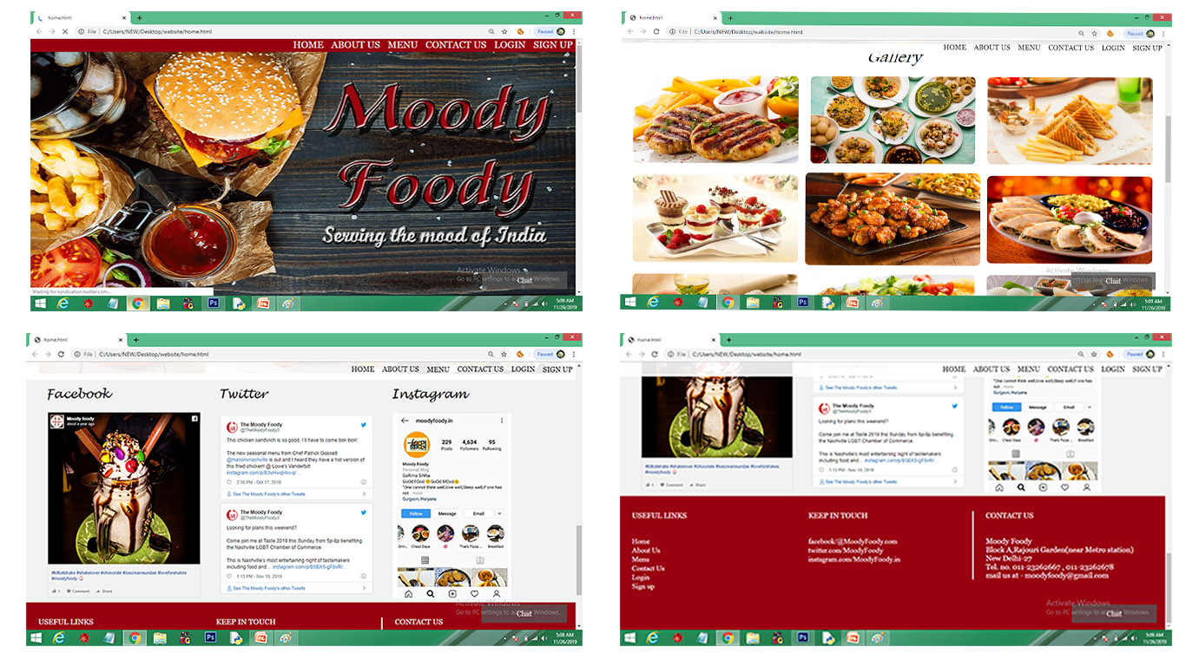

Slide 7
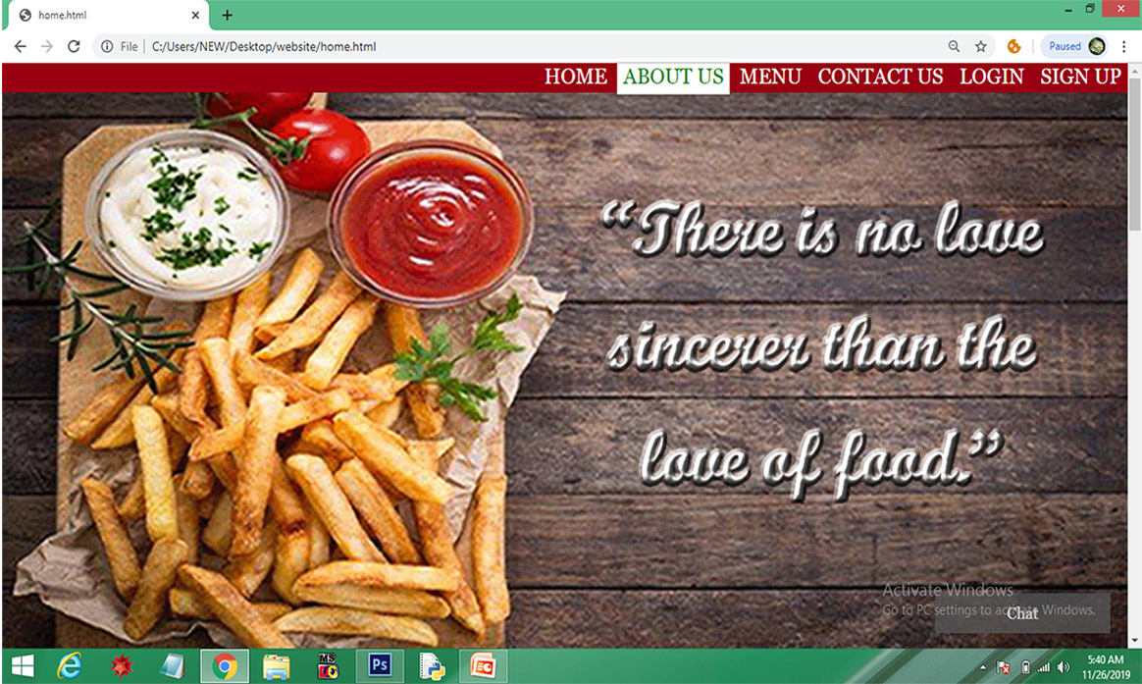
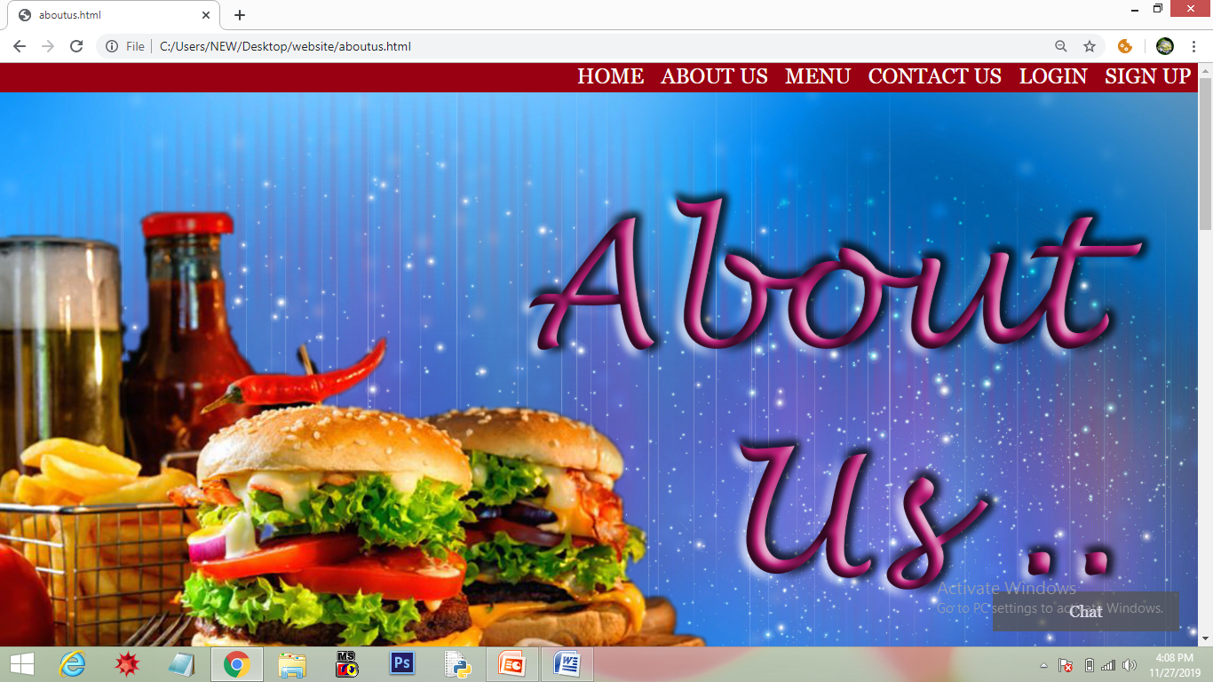
1. NAVIGATION BAR
When we hover over the Bar , the color of text changes to green and background color to white.
When we click on it, that page loads on the same window.

Slide 8
2. GIF
A GIF is created through Photoshop displaying the website title and some quotations on food. The timing between each consecutive slide is 10 sec.
As the user scrolls the website, a menu bar appears with a opacity 0.9 so that user can jump to any webpage anytime.
3. GALLERY
Gallery contains images of the food in 3 columns and 3 rows. This structure is created through nested <div> tag and CSS styling.

Slide 9
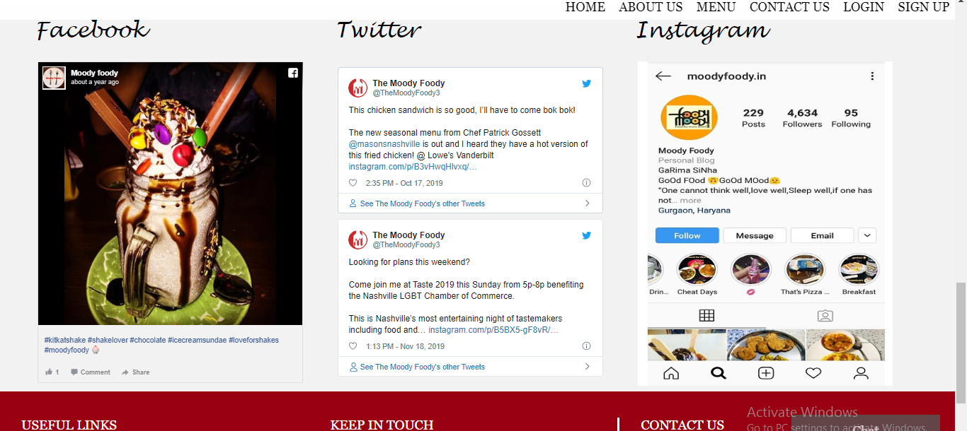
3. FEEDS
Feeds of Facebook and twitter is added through embed option. Instagram page is am image that is added through <img> tag nested in a <div> tag.
When the user click over the feed/image, particular page is opened in new tab.
The structure is created through nested <div> tag and styled by CSS.

Slide 10
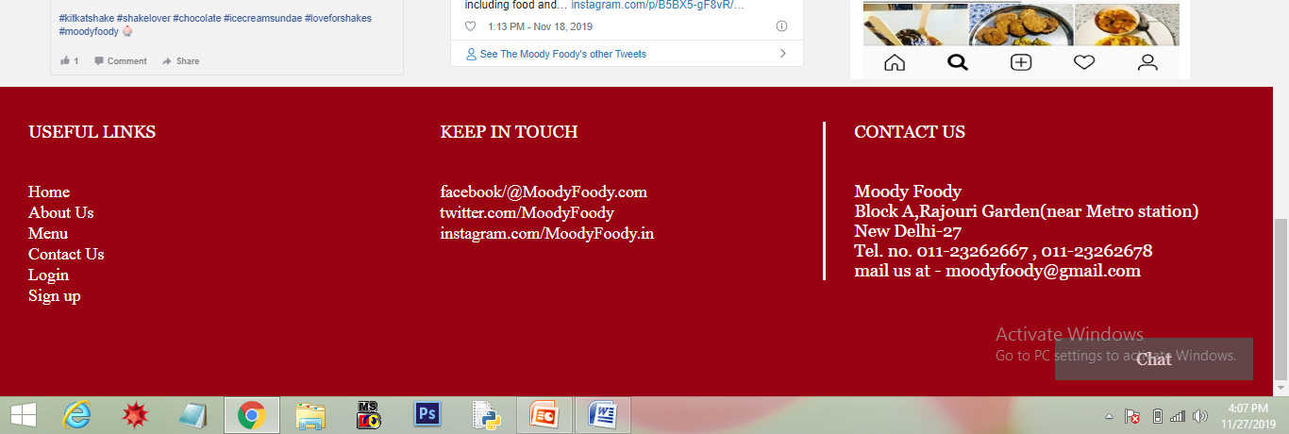
4. FOOTER
Footer is divided into 3 sections using <div> tag.
1.“USEFUL LINKS” – It contains all the links to the various pages of the website.
2.“KEEP IN TOUCH” - It contain links to the social platforms(facebook, instagram and twitter).
3.It contains the address , Contact no. and Email Id of Moody Foody.
The first two sections contains links , so when we hover over it , color changes to yellow(through CSS).

Slide 11
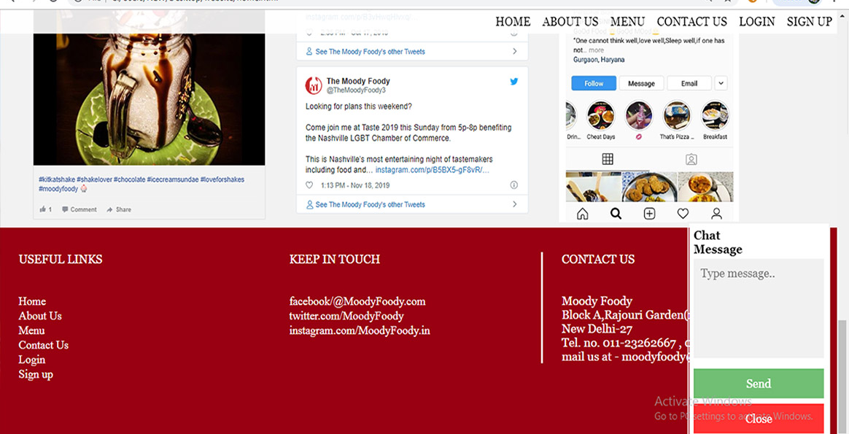
5. POPUP CHAT WINDOW
At the bottom of every page, there is a chat icon, on clicking the chat button ,a chat window will open .The user can ask his/her queries through it.

Slide 12
MENU
We can navigate to menu either through navigation bar or through links given in the footer.
Menu have 2 sections:-
(a) Header (created through photoshop).
(b) Slide show Gallery.
Each menu is created through tools in photoshop.
The slide gallery is created through javasrcipt and it’s styling is done by css and alignment through html <div> tag.
To slide the menus’ the user can either use buttons on left and right side or through a gallery created just below it.

Slide 13
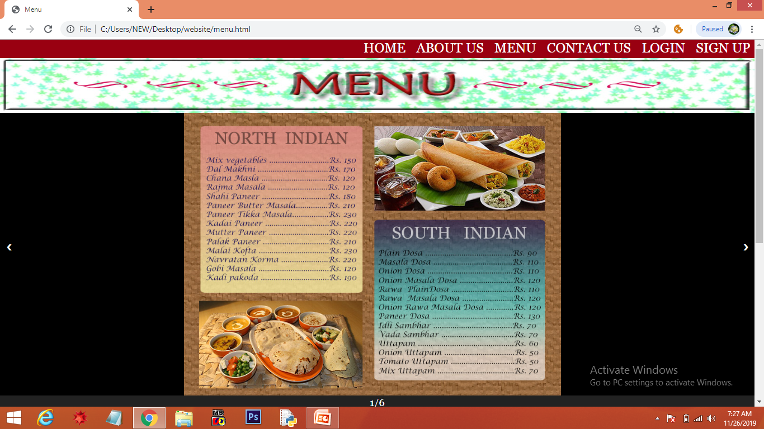
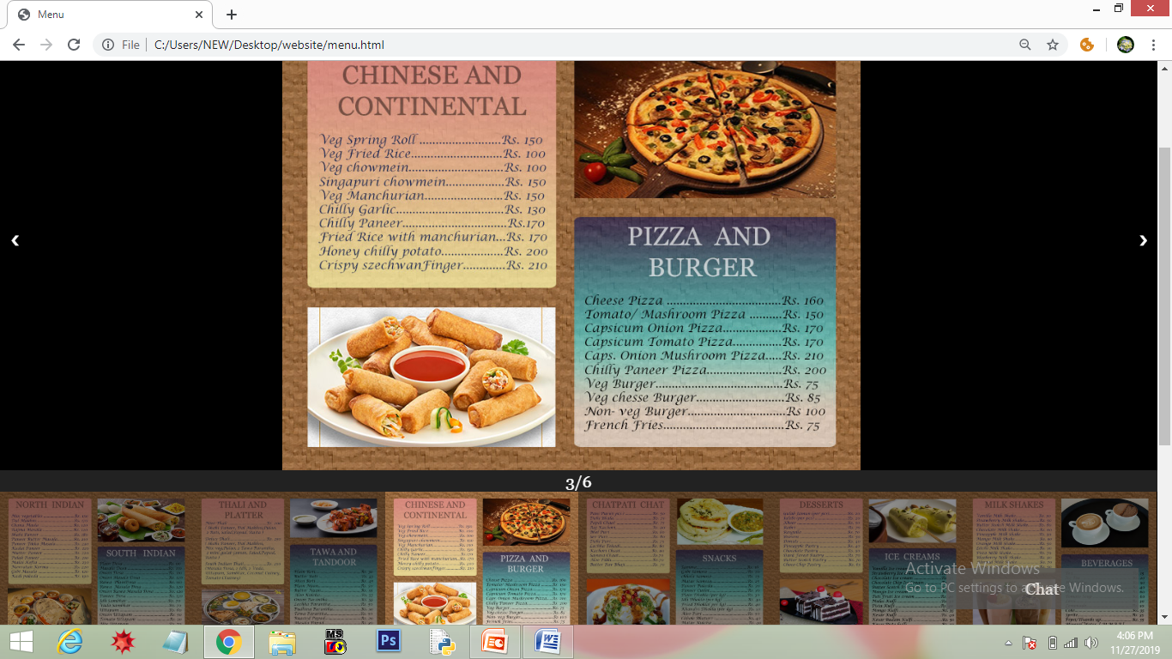
Header
If the user clicks on the 3rd menu , then 3rd menu will be displayed in slideshow from gallery.
By default, when page is loaded, first menu page is opened in slideshow.

Slide 14
ABOUT US
You can navigate to “About Us” either through navigation bar or link in footer.
About Us page have 3 sections:
(a) Image (created through photoshop).
(b) About the concept “moody Foody”.
(c) Images of Team members with their details.

Slide 15
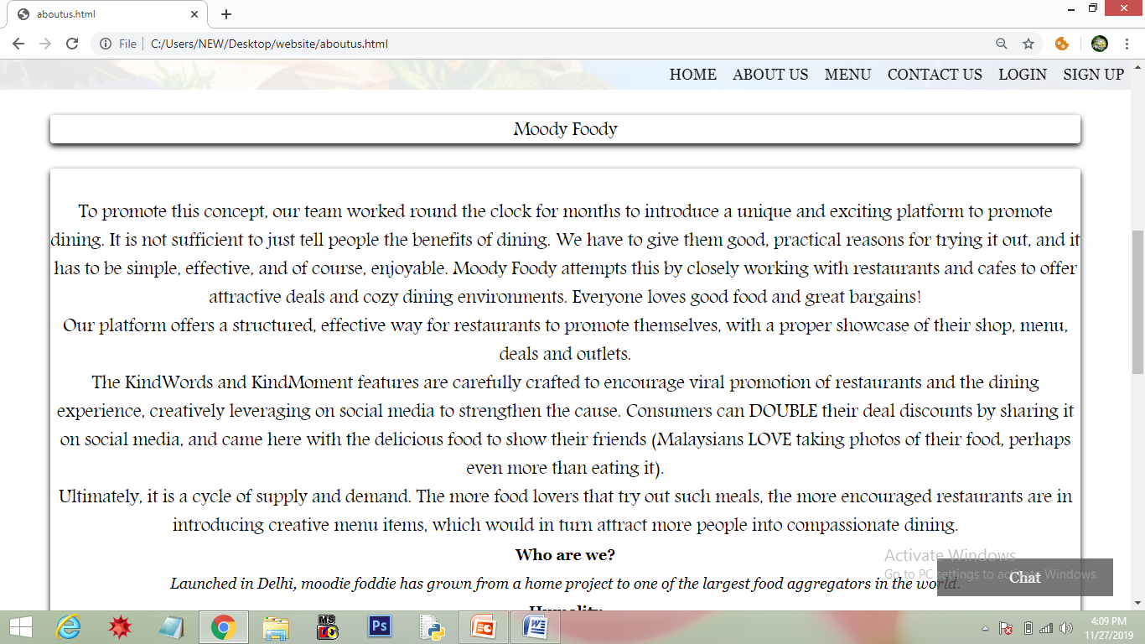
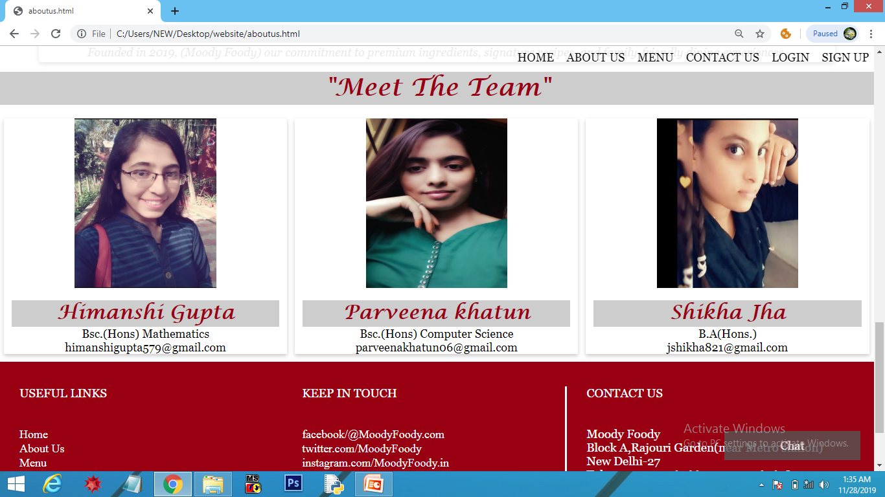
Image
About “Moody Foody”
Team Members

Slide 16
CONTACT US
The user can give his/her suggestions and feedback through the Contact Form.
The form is user friendly as it contains minimum fields .
Fields in form:-
First Name, Last Name, City, suggestions.
After entering the data in the contact form , the user can click the send button or link . As soon as link is clicked, email will sent.

Slide 17
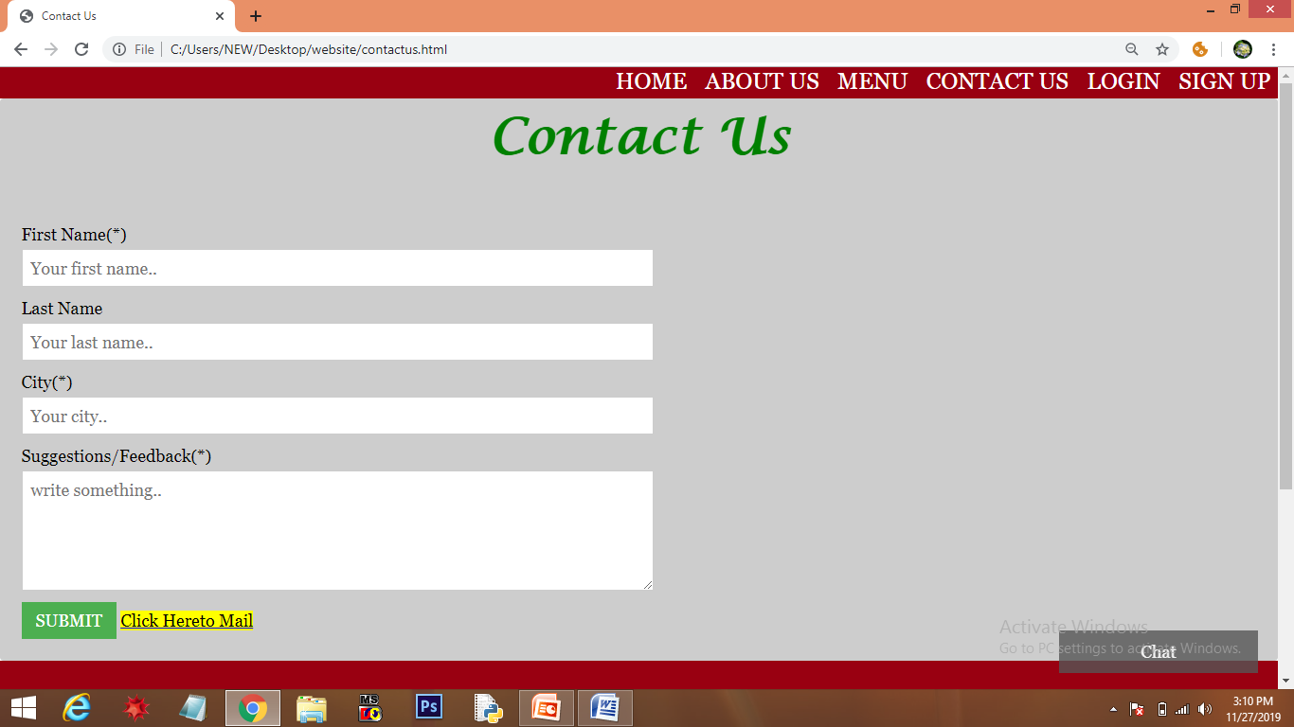

Slide 18
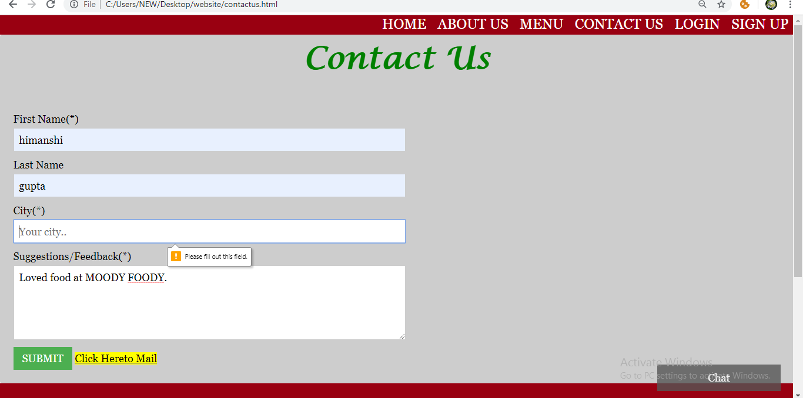
Validation is being added to the form. Till the user enter all the necessary details, he/she cannot submit the form.

Slide 19
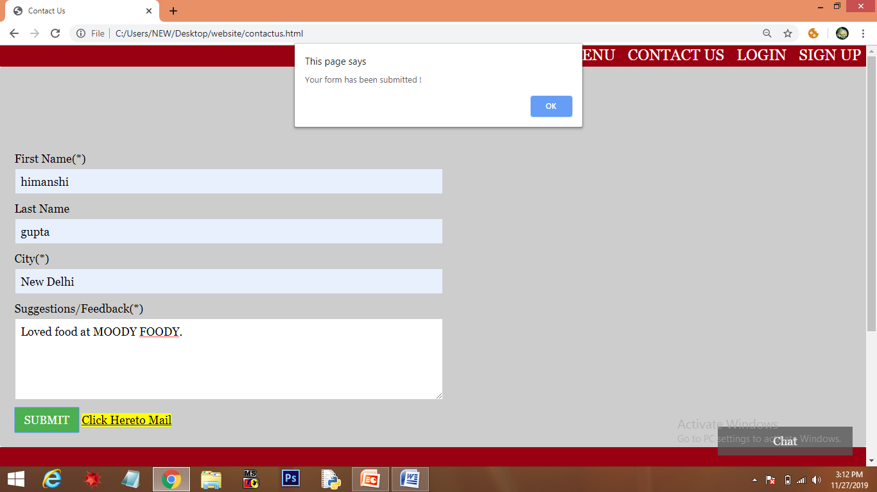
Javascript event handler is added to the form. When the user submit the form, javascript function is called through ‘onclick’ (event handler) which alerts a message that “Your form has been submitted”.

Slide 20
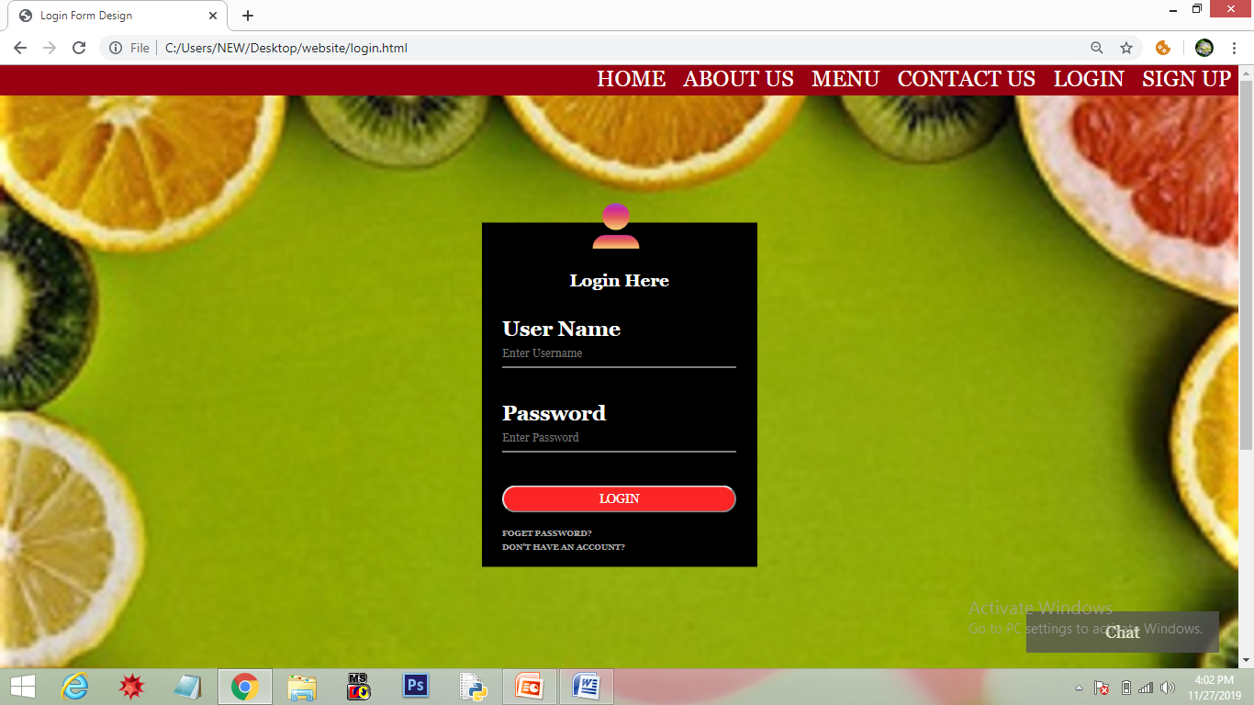
LOGIN
The existing users can login through ‘LOGIN’ in navigation bar or through link in the footer.
The user requires a ‘user name’ and ‘password’ to login .

Slide 21
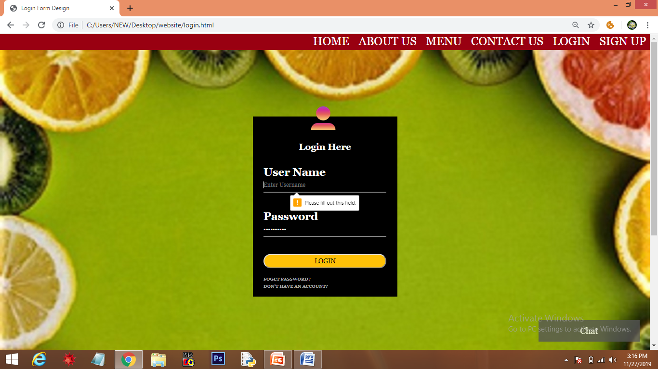
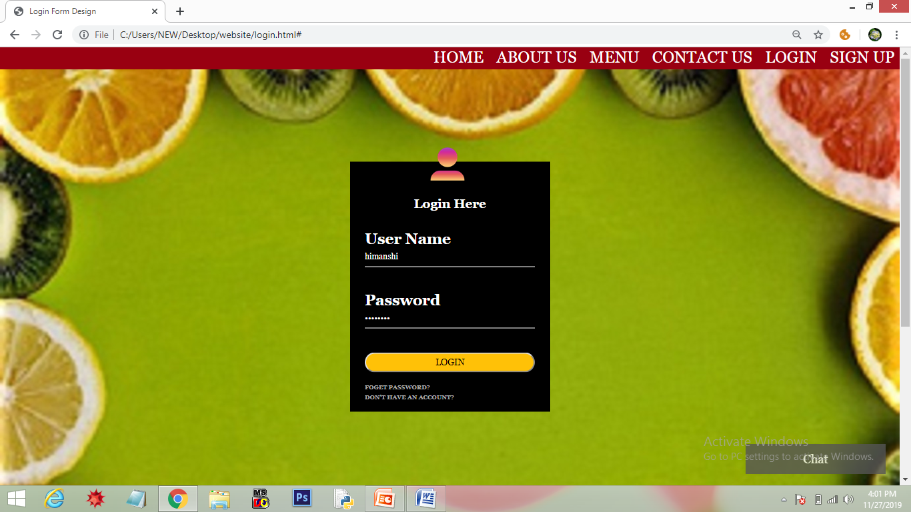
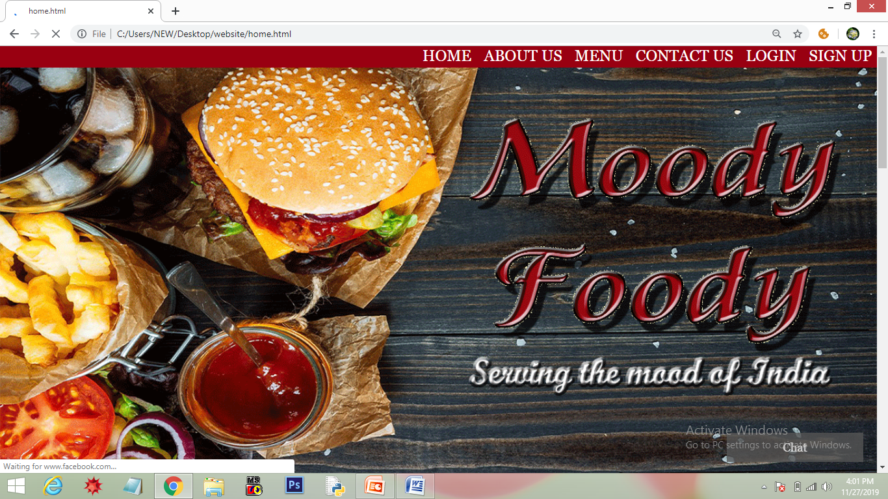
Data Validation is been added to the form. Both ‘User name’ and ‘password’ are necessary to login’.
As the user hover over login button, color changes from red to yellow.(implemented through css)
When the user login, home page is loaded automatically

Slide 22
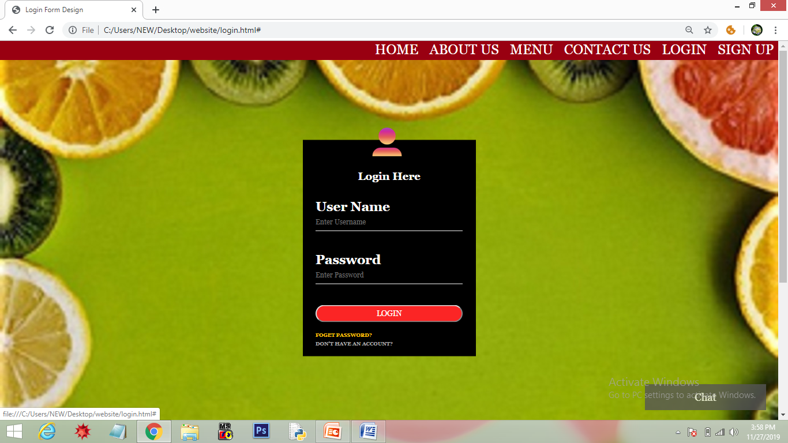
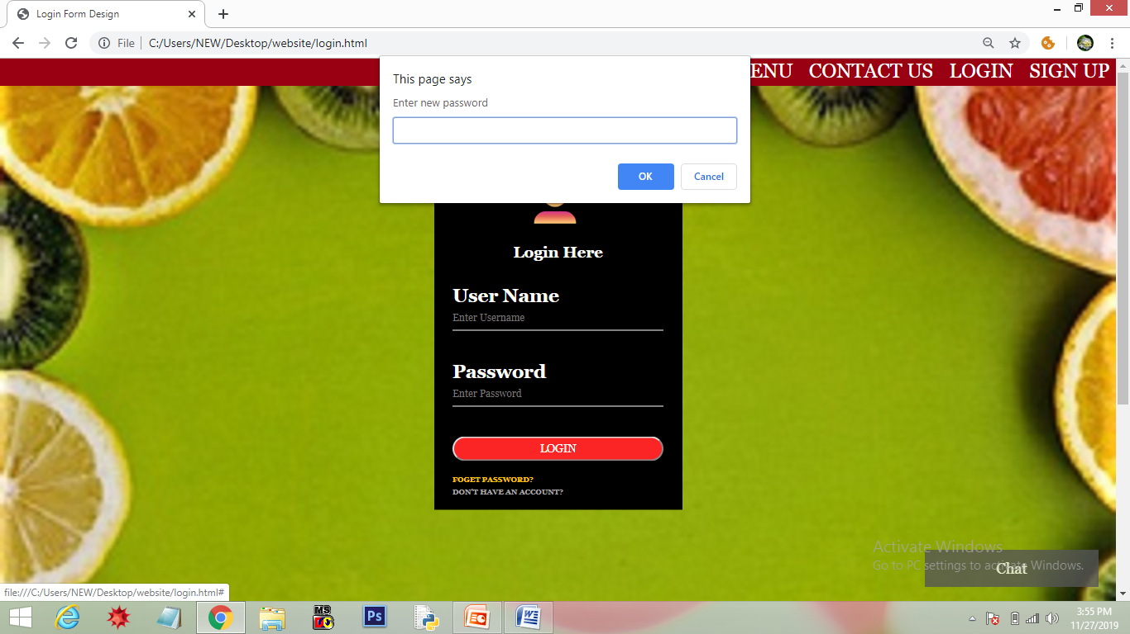
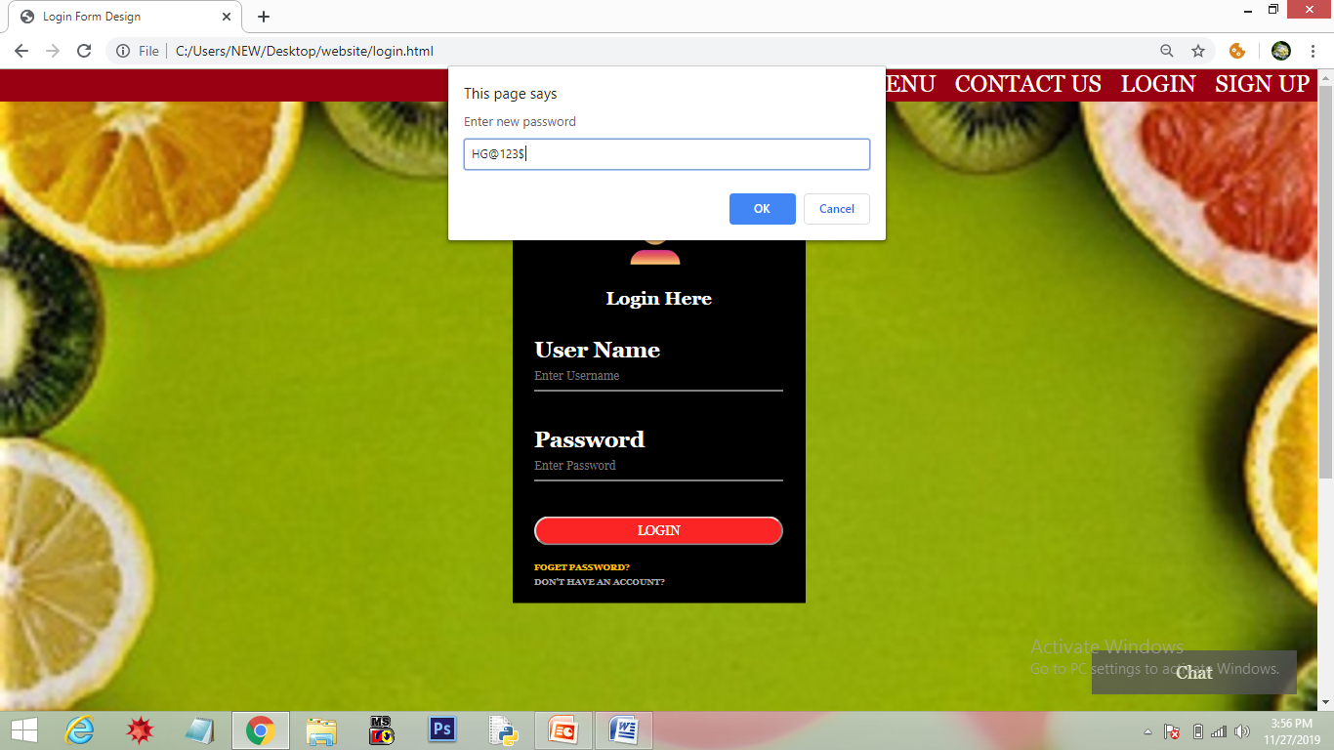
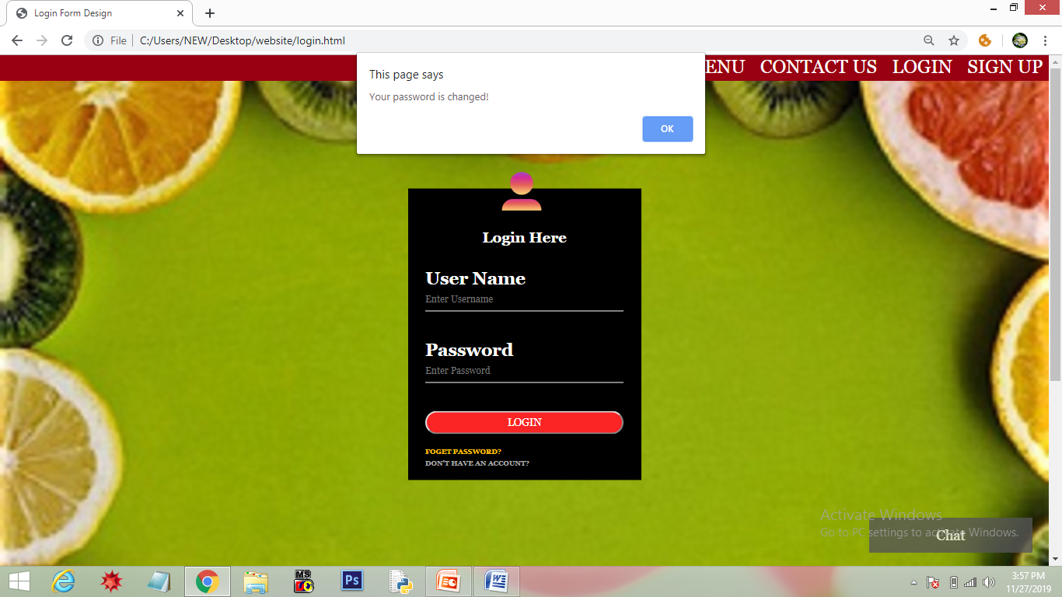
In case the user forgets the password, he/ she can click “FORGET PASSWORD” link.
When the user clicks on it, a prompt box is displayed asking for new password.
When the user enters the password and click ‘OK’, an alert is displayed “Your password is changed”.

Slide 23

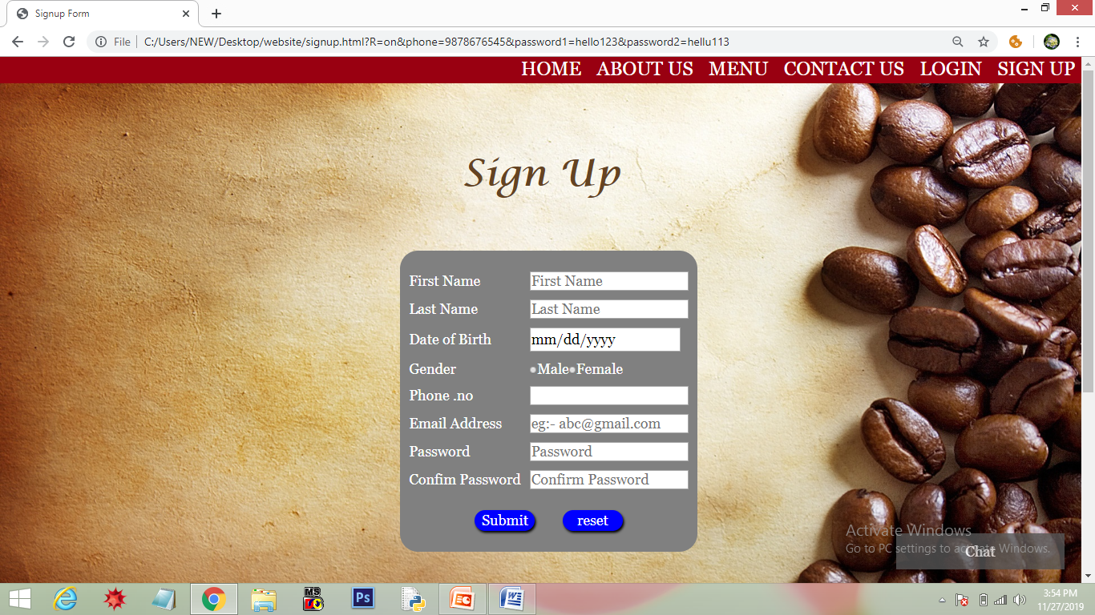
In case of new user, he/she can click “DON’T HAVE AN ACCOUNT” .(As user hover ,color changes from grey to yellow through css)
As user click on it, signup page is loaded

Slide 24
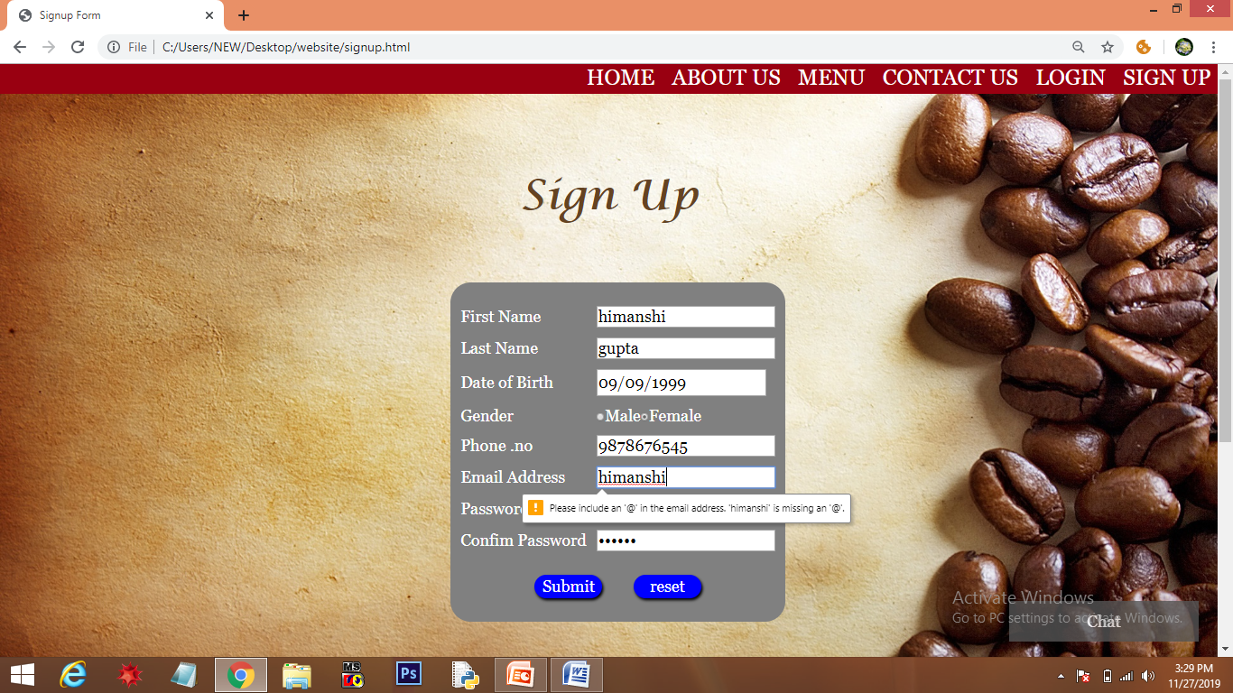
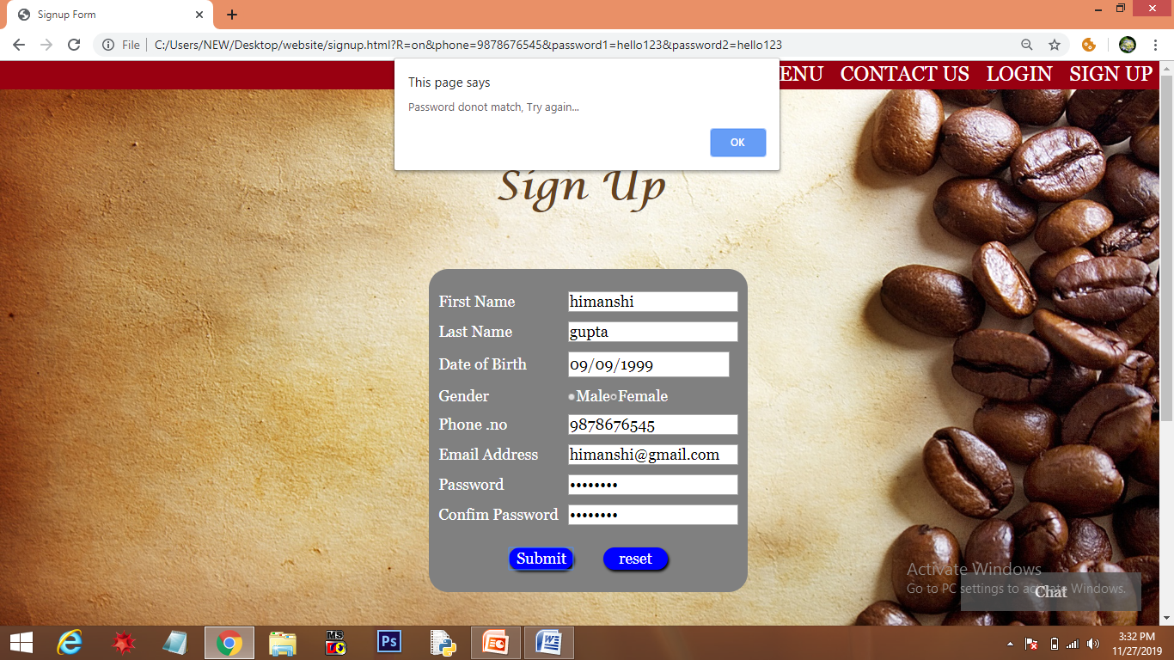
SIGN UP
If a user wants to open an account, he/ she has to signup either through navigation bar or link in footer.
Data Validation is added to the form. All the necessary details need to be filled up correctly
In case the password didn’t match , an alert message is displayed “Password donot match, Try again…” and on clicking ‘OK’ form is refreshed.

Slide 25

When all the details are correct and user clicks on ‘submit’ , an alert message is displayed “Signed up successfully”.
If user wants to edit form, he/ she can click on ‘reset’ button to refresh the form.

Slide 26
CONCLUSION AND FUTURE SCOPE
The objective of this project is to create a website for the food lovers. The website has been made to fulfill basic requirements of a website using creative ideas. There is always a room for improvement in any website.
Website could be made more responsive so that it can be compatible
to different platforms.
Online Ordering and delivering option could be added.
A logo could be added that would help to promote the brand.
Every effort has been made to make it user friendly.

Slide 27
Thank You

